Slide 1


LAB -8 Exploit windows 7
Matasploitable Framework
Name :- Makwana Yash K Subject :- Ethical Hacking Roll No :- P23IS016

Slide 2

Tools
1
Oracle Vm VirtulBox
2
Kali
3
Windows

Slide 3
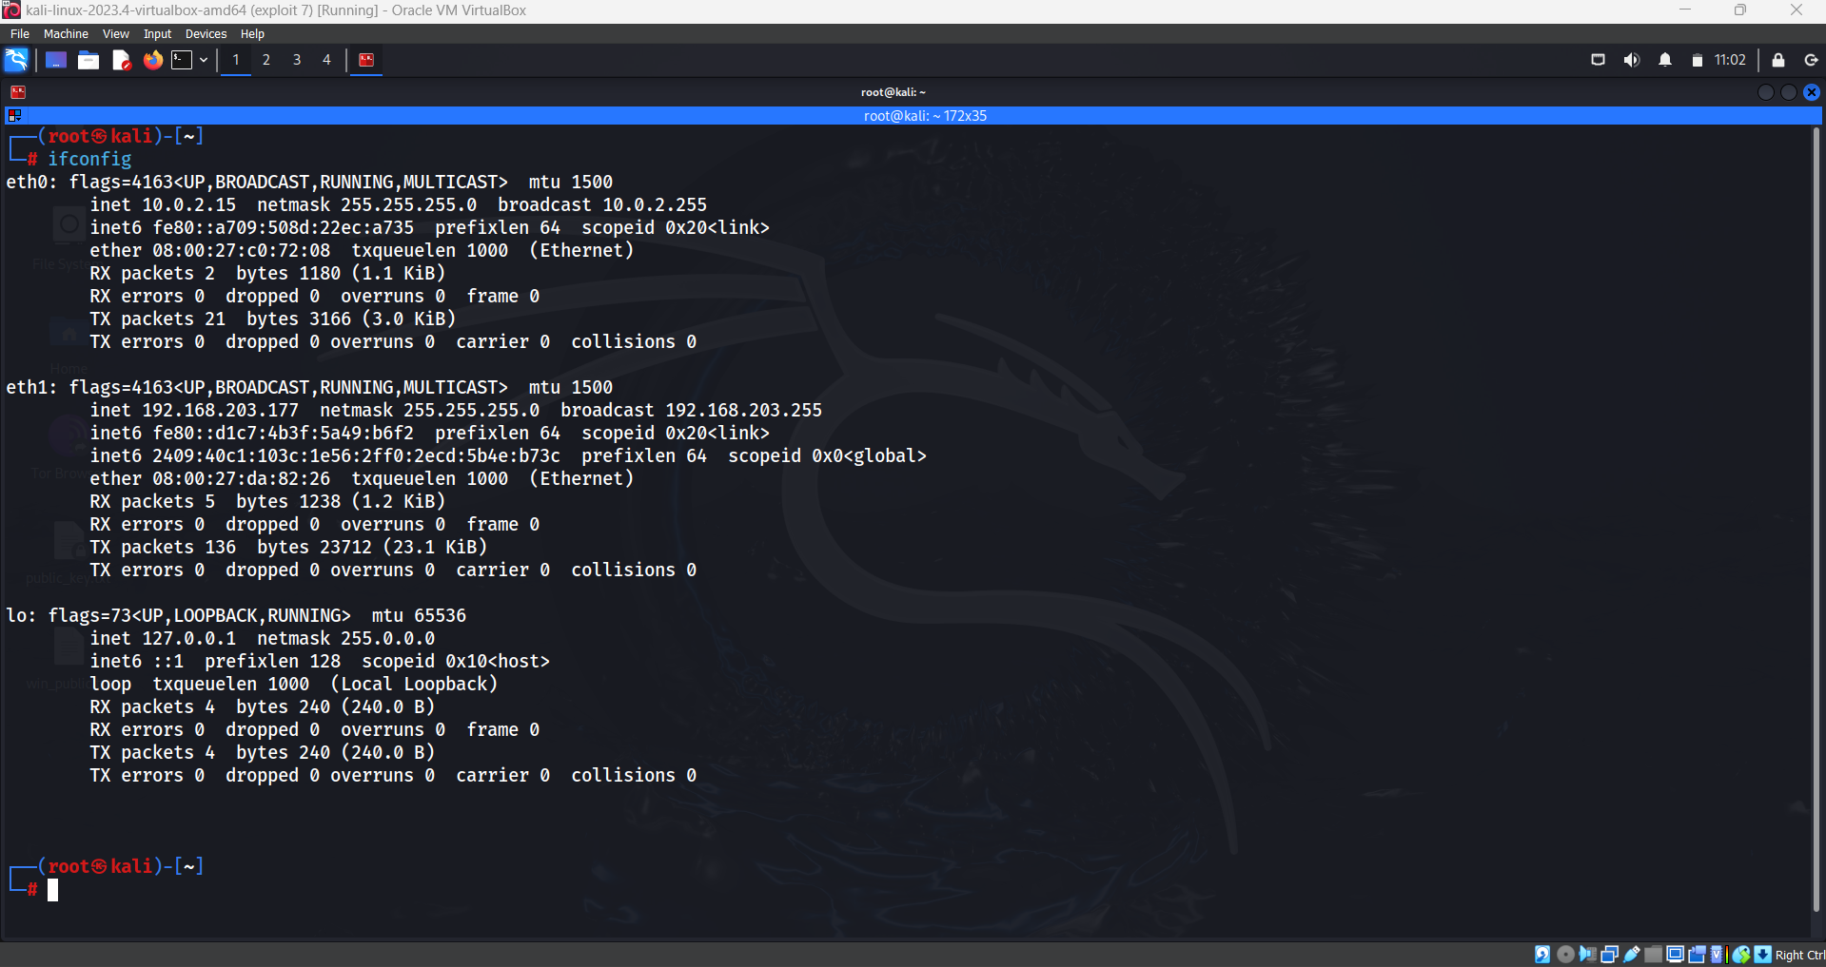
Kali Linux

Slide 4
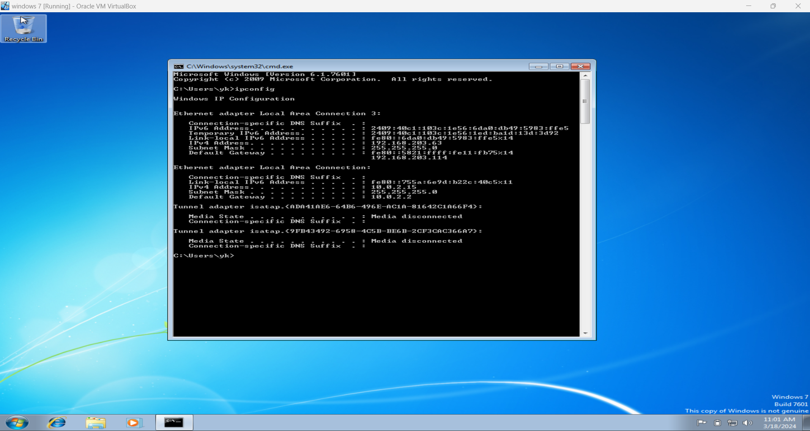
Windows

Slide 5
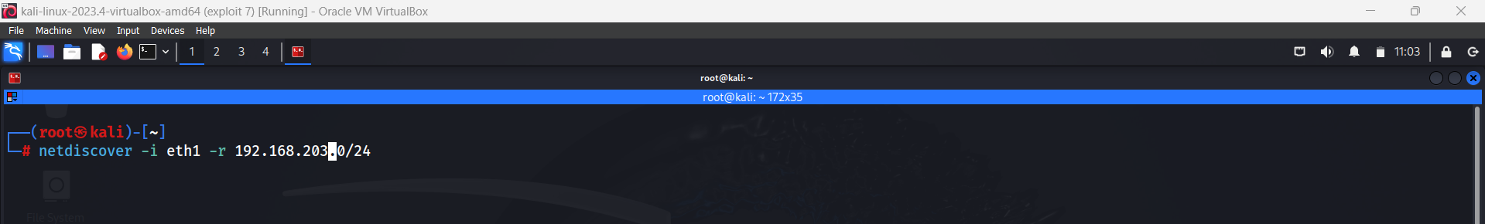
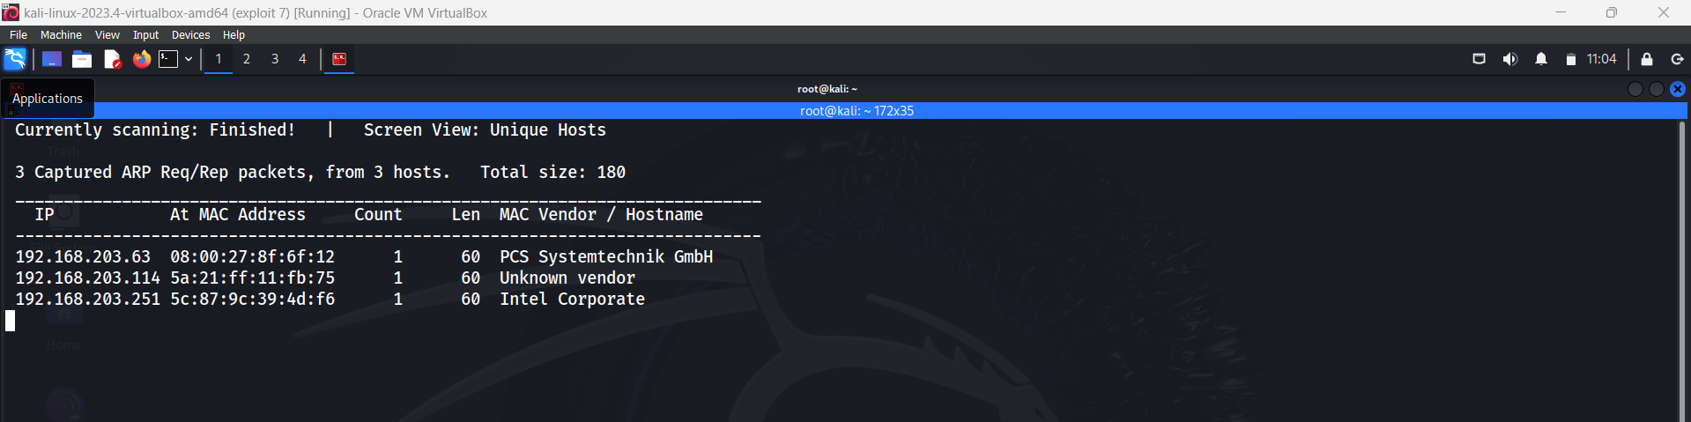
Kali Linux :-
Netdiscover

Slide 6
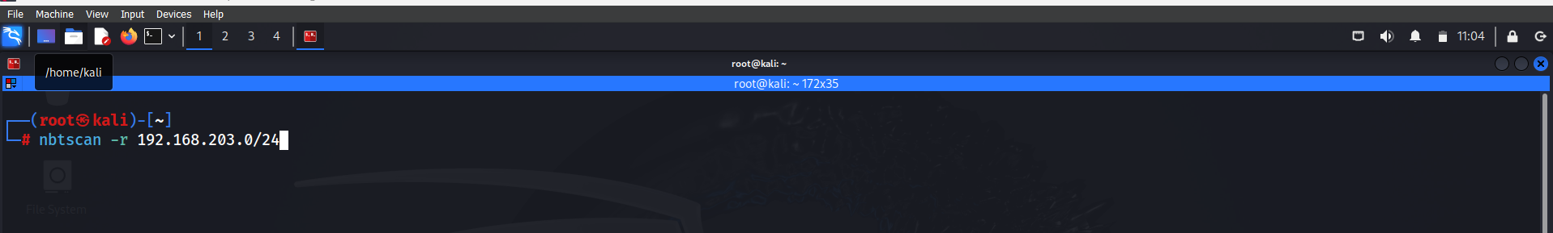
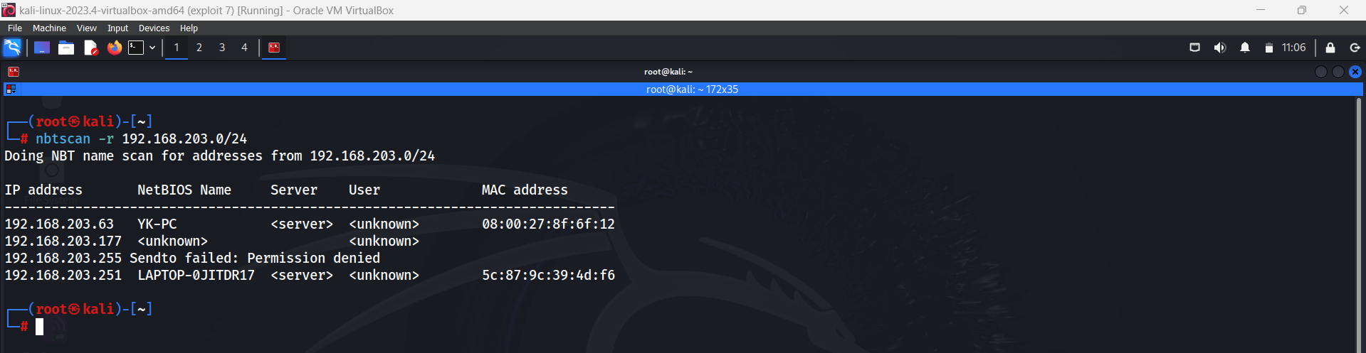
Kali Linux :-
nbtscan

Slide 7
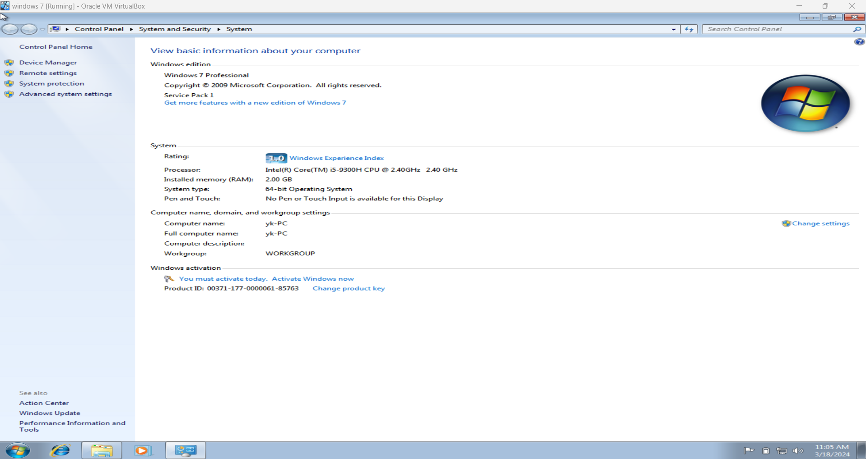
Windows

Slide 8
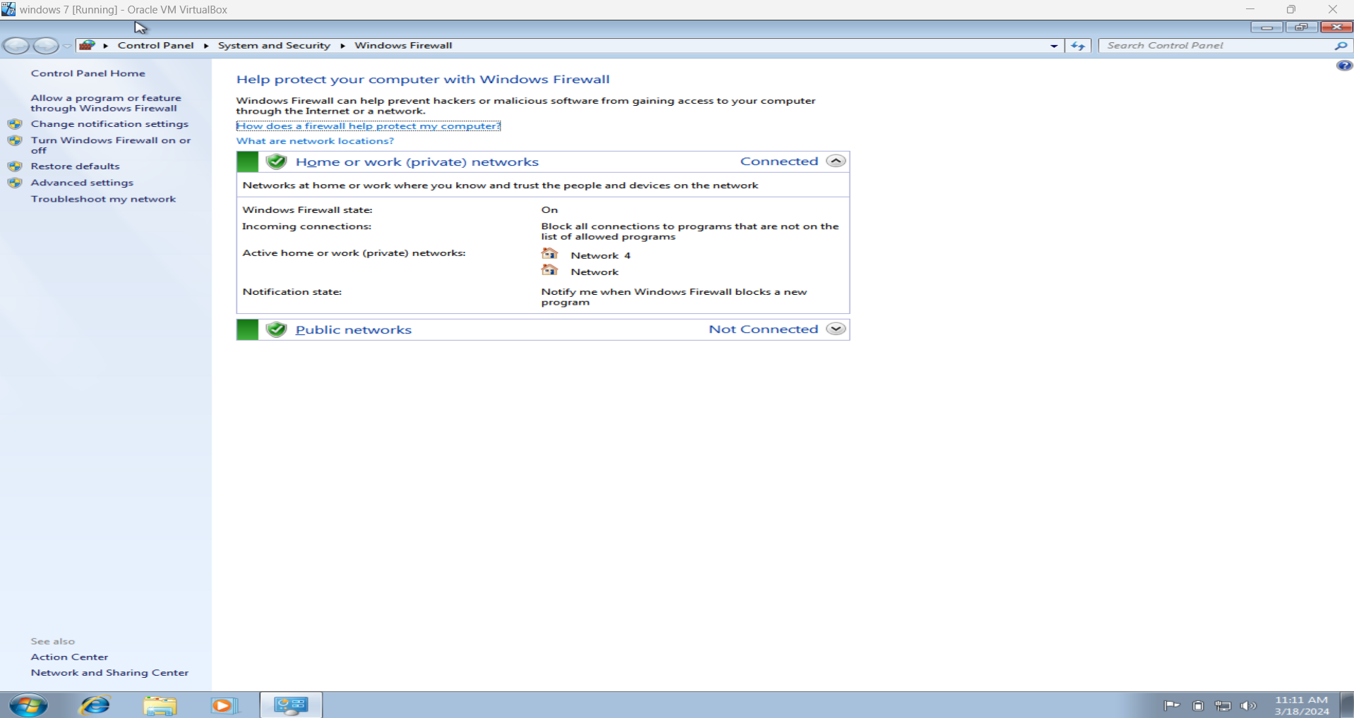
Windows Firewall

Slide 9
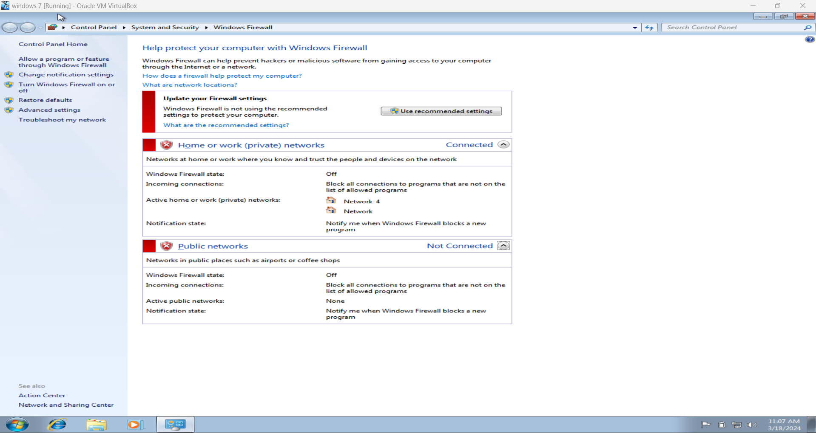
Windows Firewall :Turn Off For Testing Purpose

Slide 10
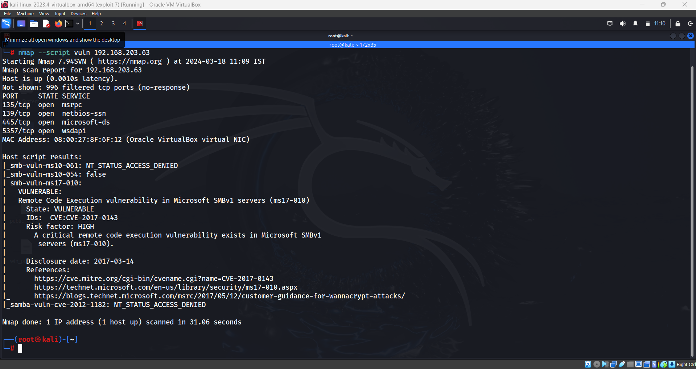
Kali :- Scan Vulnerability in windows

Slide 11
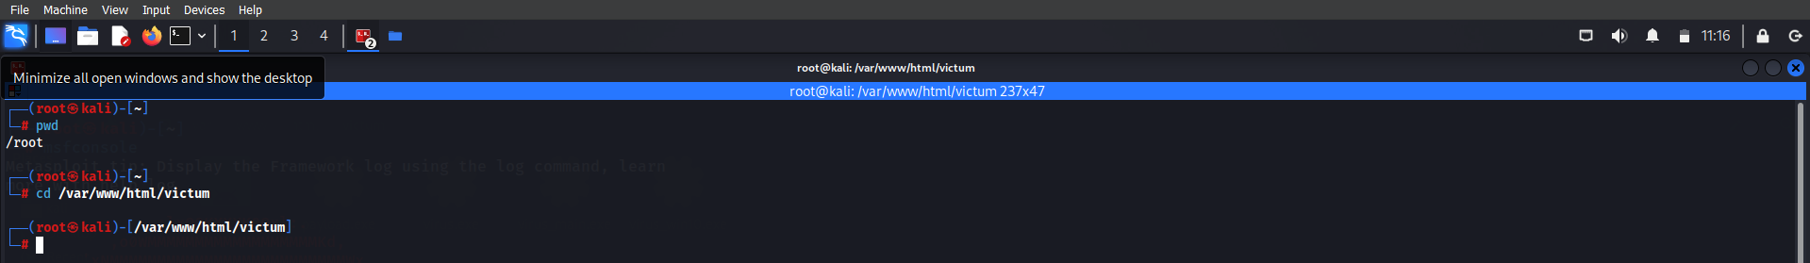
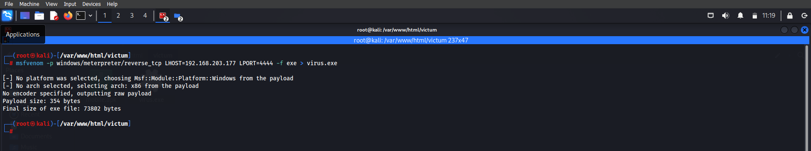
Kali :- Open New terminal -> change directory
Kali :- create executable virus

Slide 12
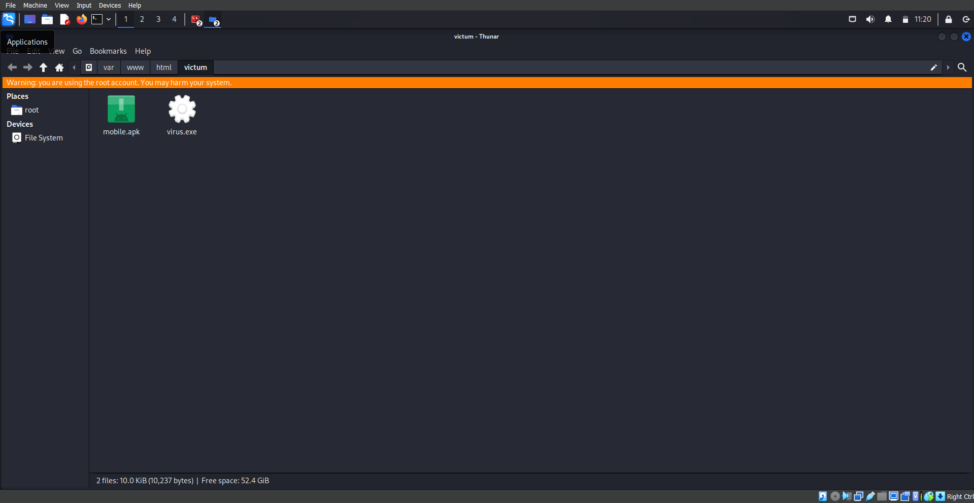
Kali :- Virus Is create

Slide 13
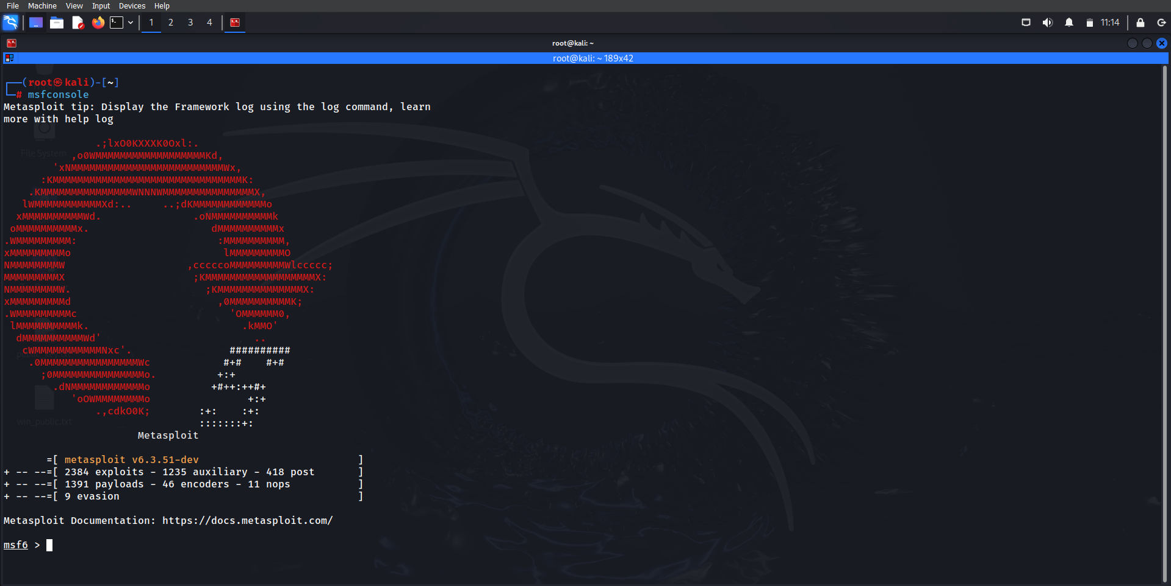
Kali :- Open Metasploit Framework

Slide 14
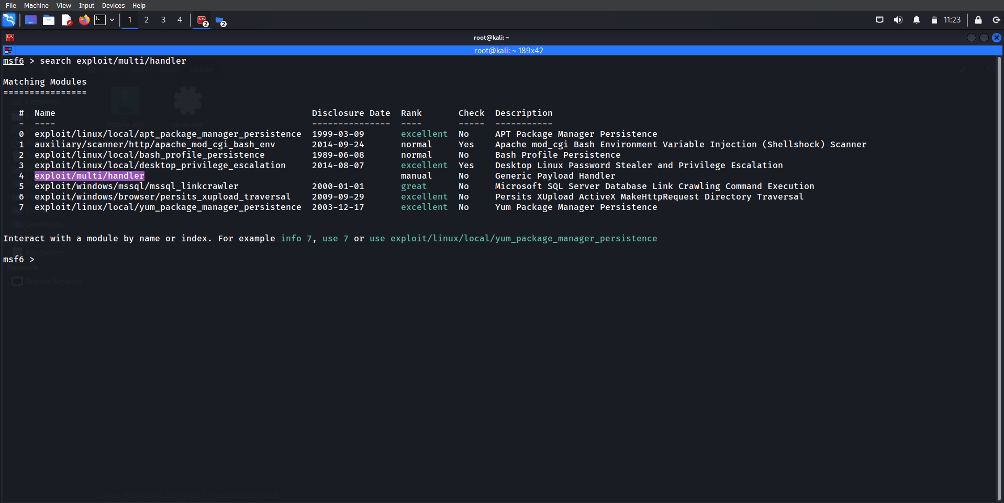
Kali :- Metasploit Framework - Search exploit/multi/handler

Slide 15
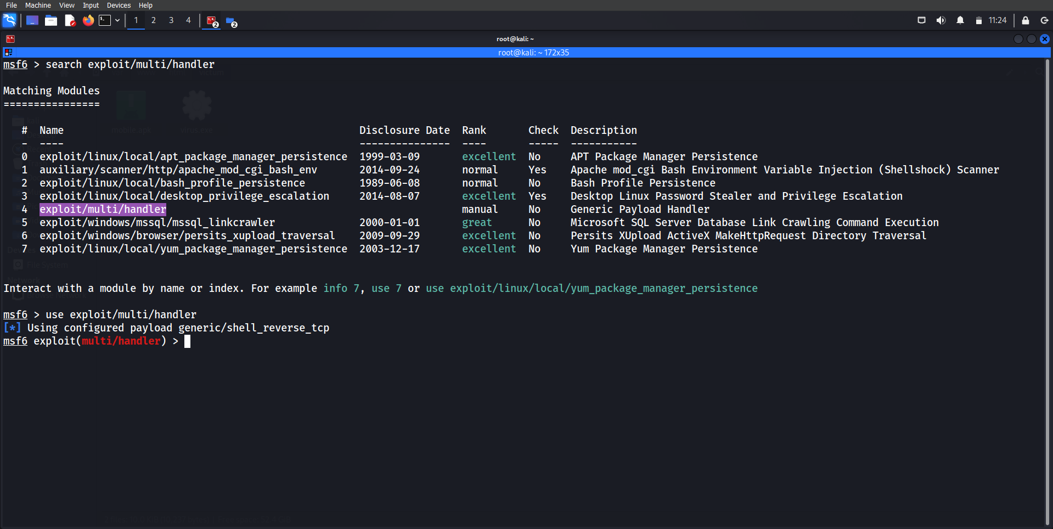
Kali :- Metasploit Framework - use exploit/multi/handler

Slide 16
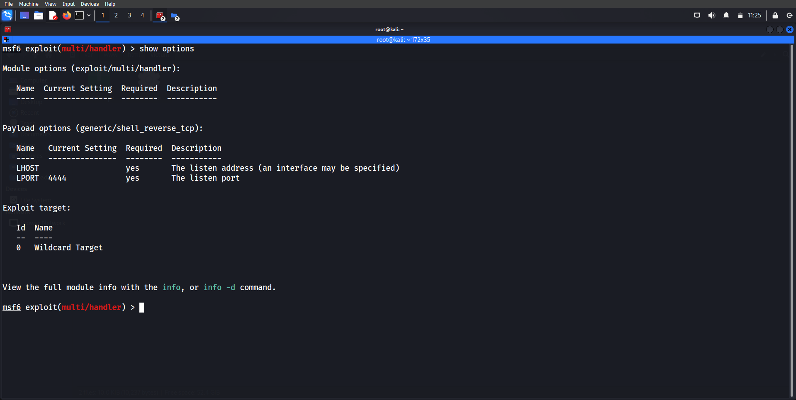
Kali :- Metasploit Framework -> show options

Slide 17
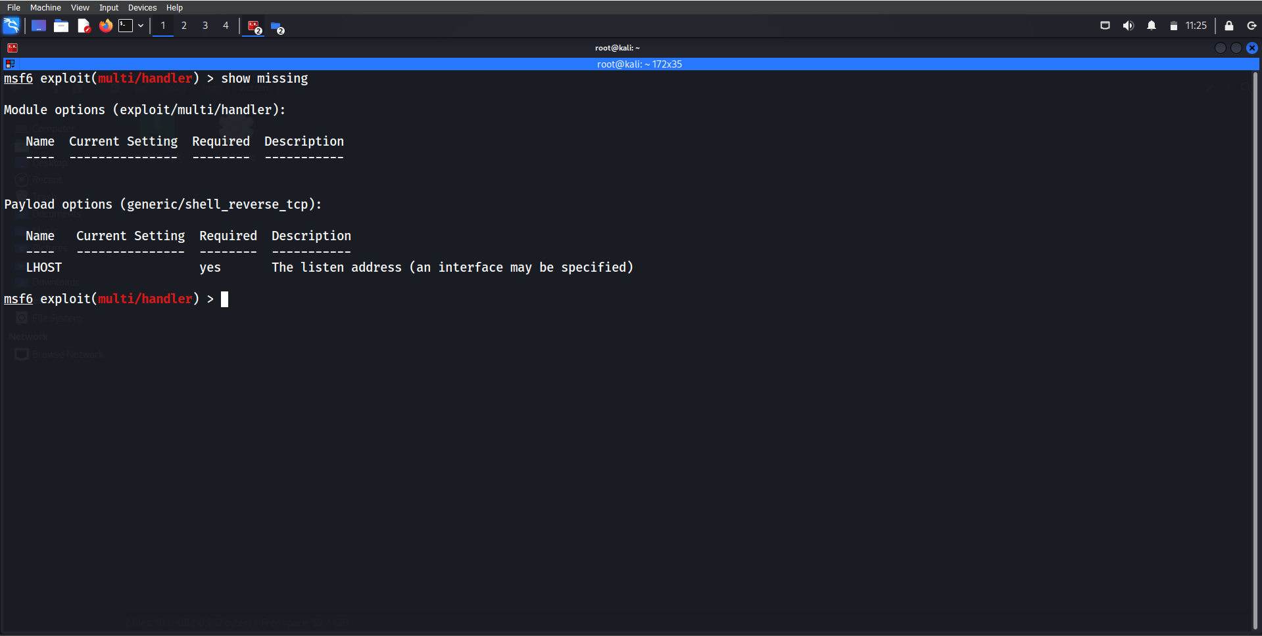
Kali :- Metasploit Framework -> show missing

Slide 18
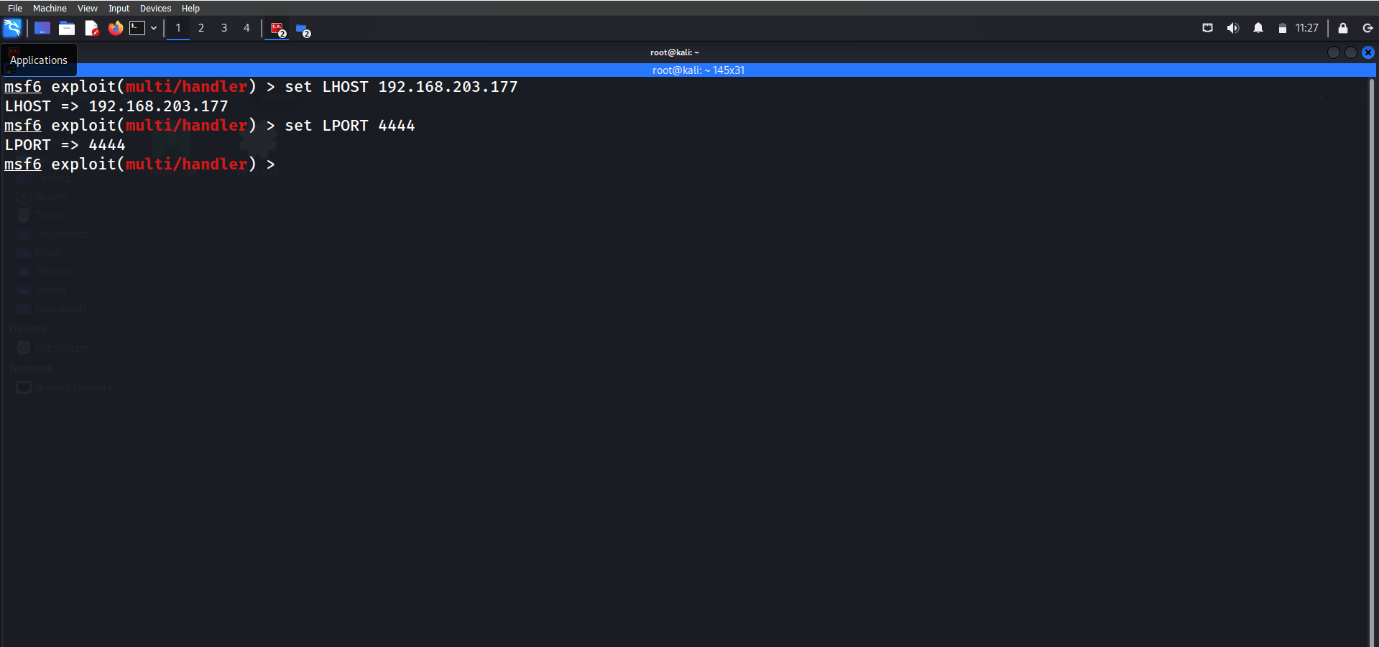
Kali :- Metasploit Framework -> set LHOST & set LPORT

Slide 19
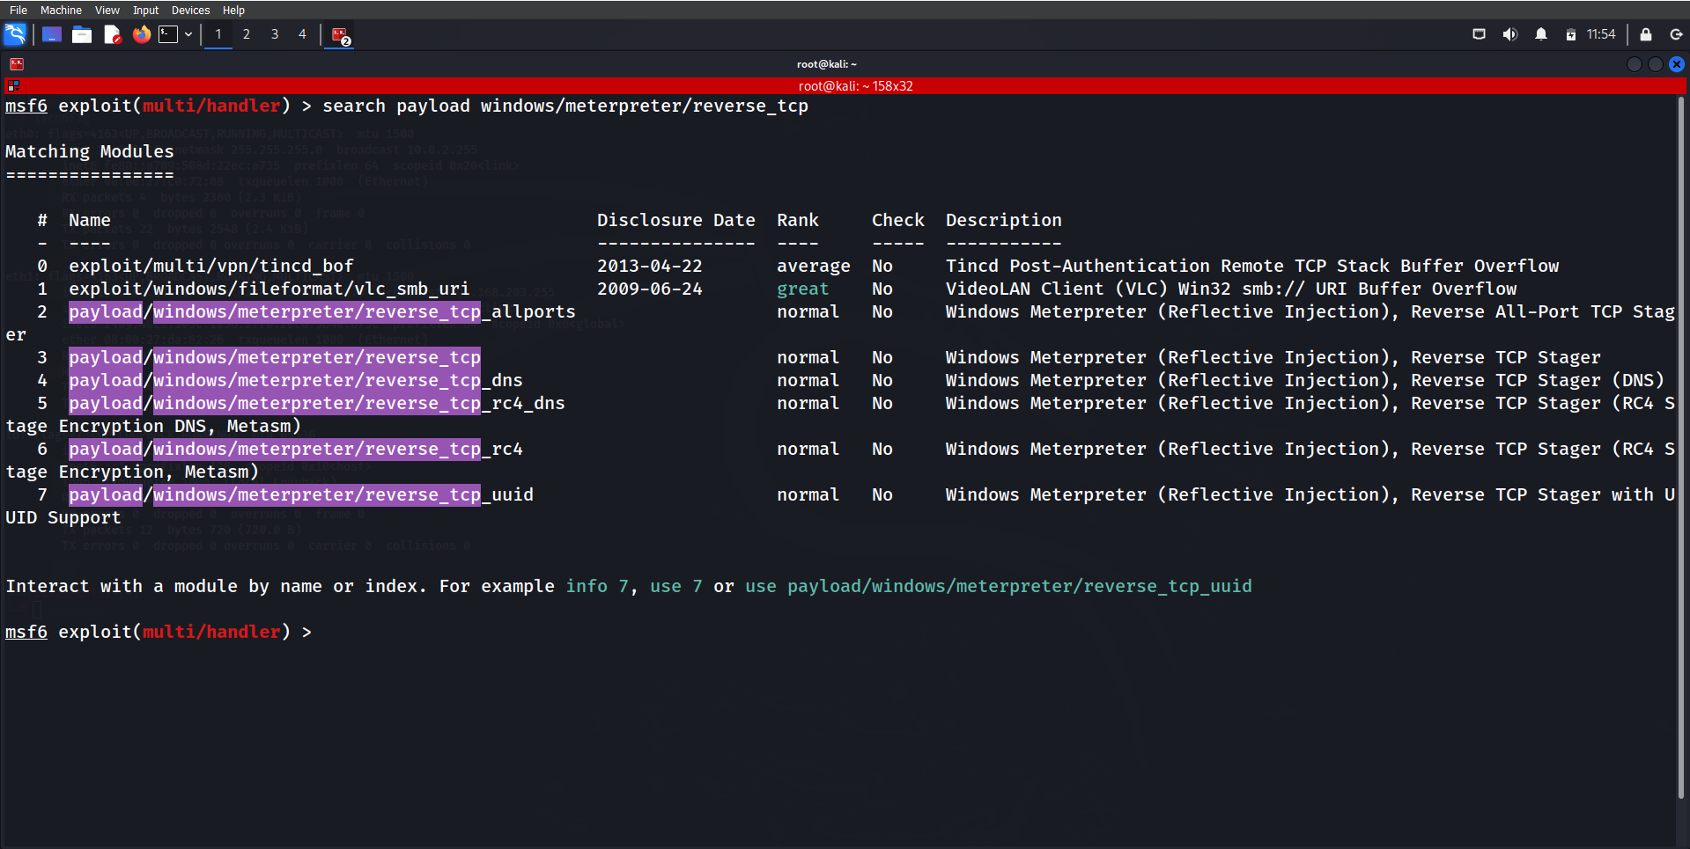
Kali :- Metasploit Framework -> search payload

Slide 20
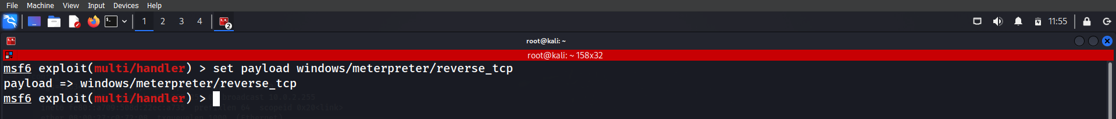
Kali :- Metasploit Framework -> set payload
Kali :- Open new Terminal and start apache2 server

Slide 21
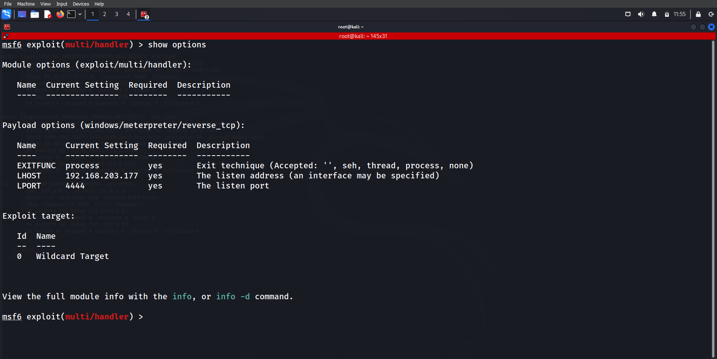
Kali :- Metasploit Framework -> check the options

Slide 22
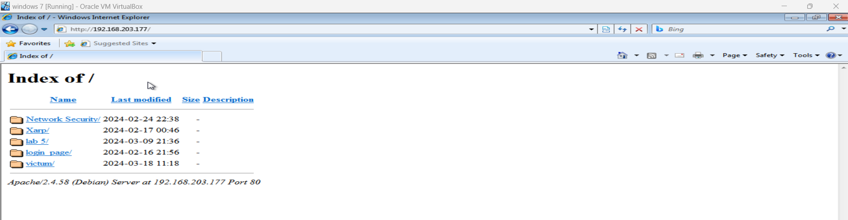
Windows :- go to Explorer -> search ip of kali machine
Windows :- it will open apache server

Slide 23
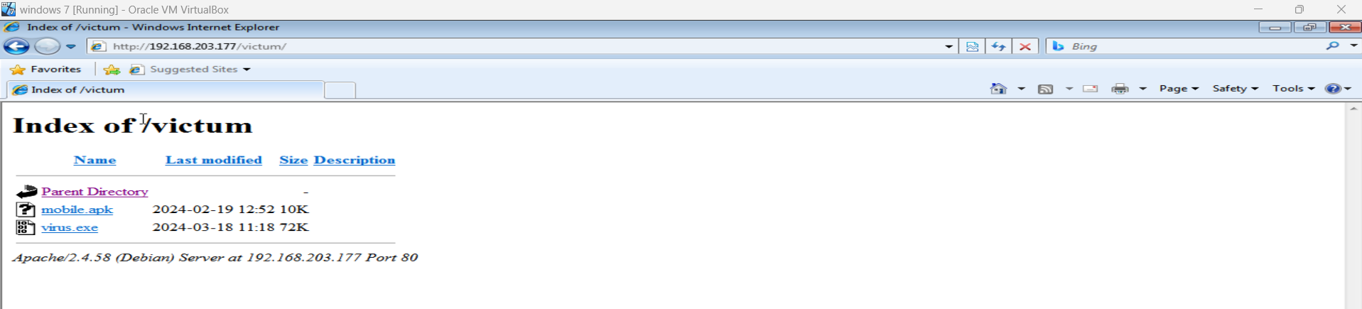
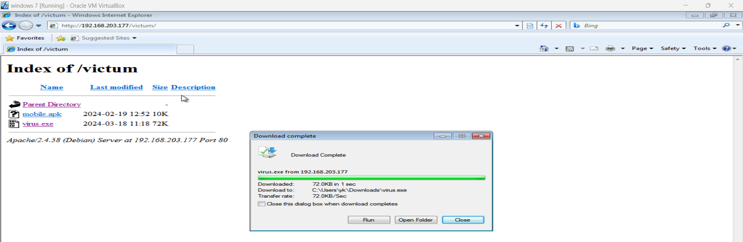
Windows :- go to victum folder
Windows :- Install virus.exe file

Slide 24
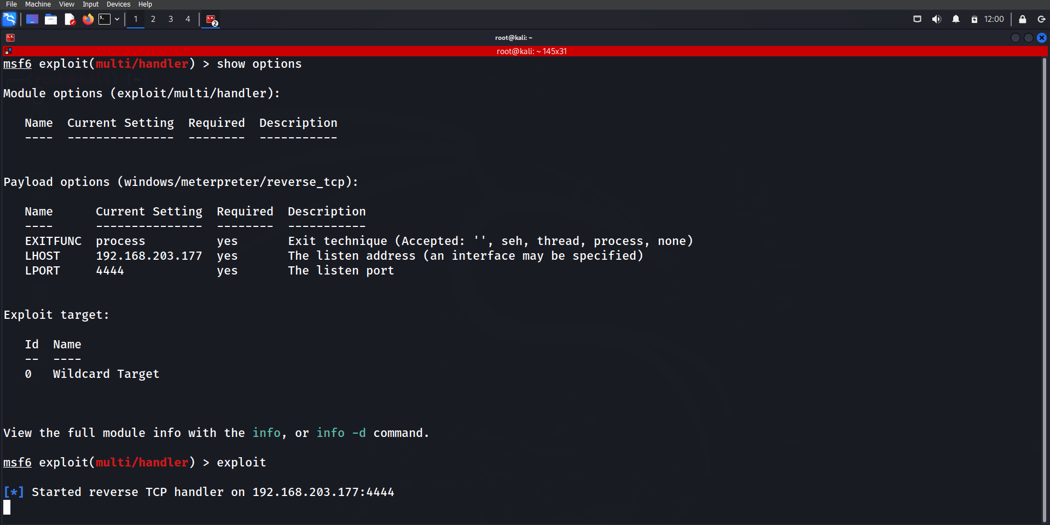
Kali :- Metasploit Framework -> Exploit

Slide 25
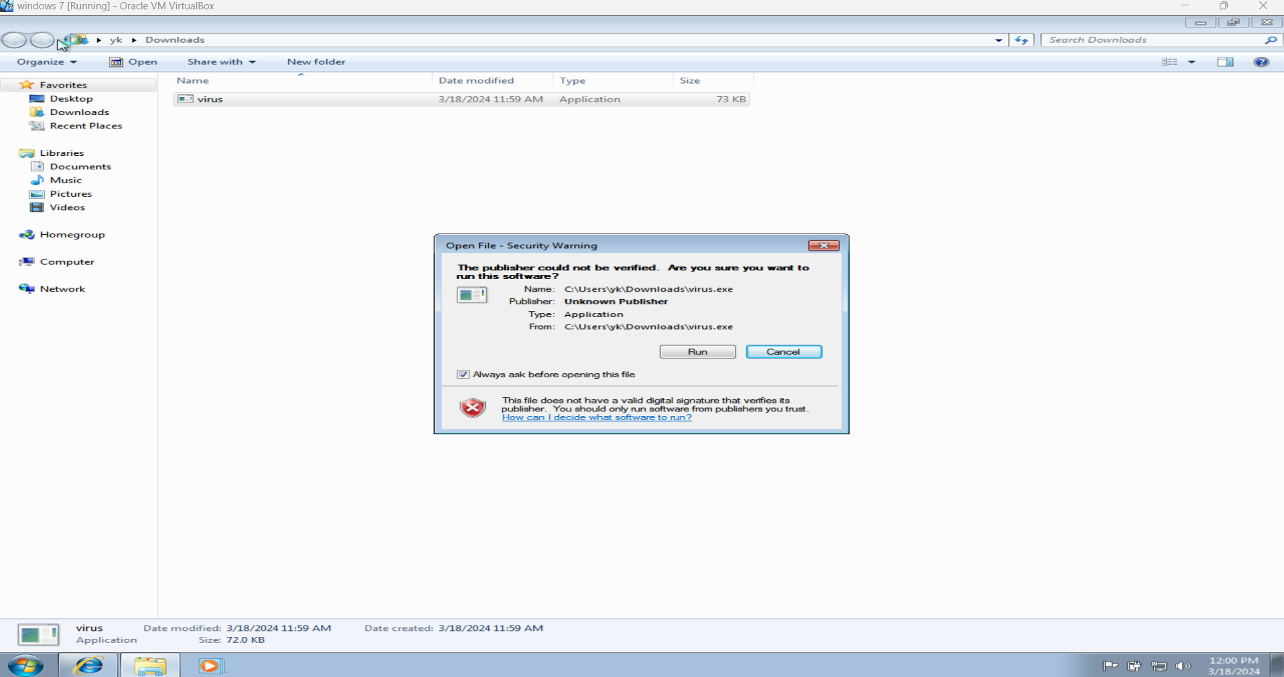
Windows :- Run -> virus.exe file

Slide 26
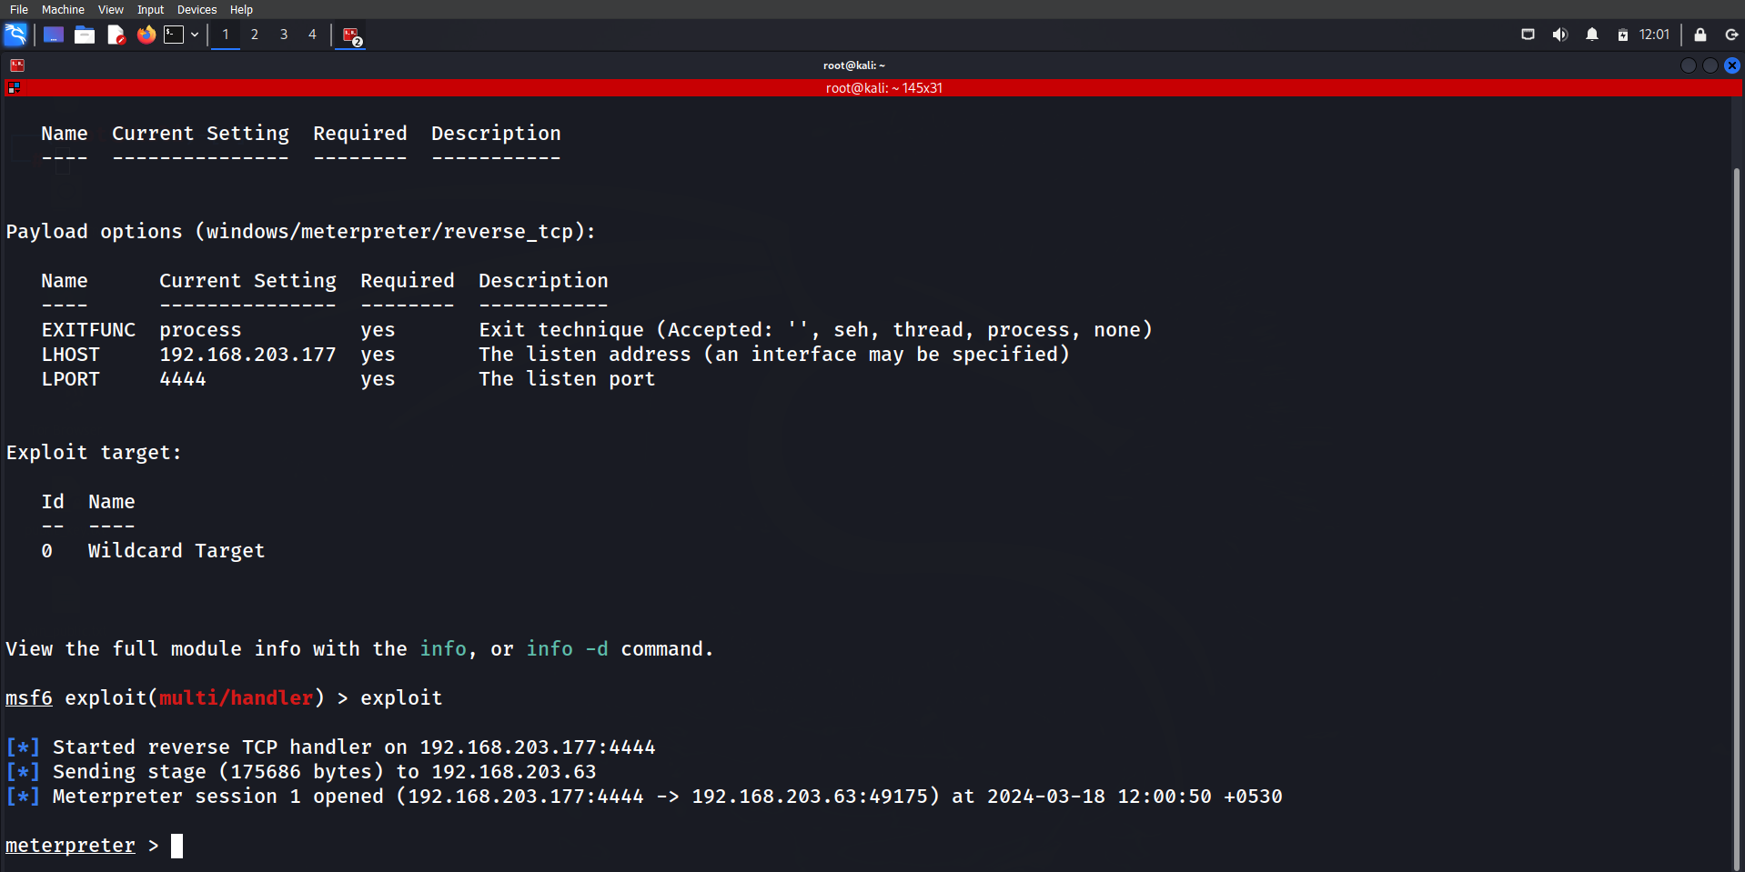
Kali :- now we successfully exploit the windows

Slide 27
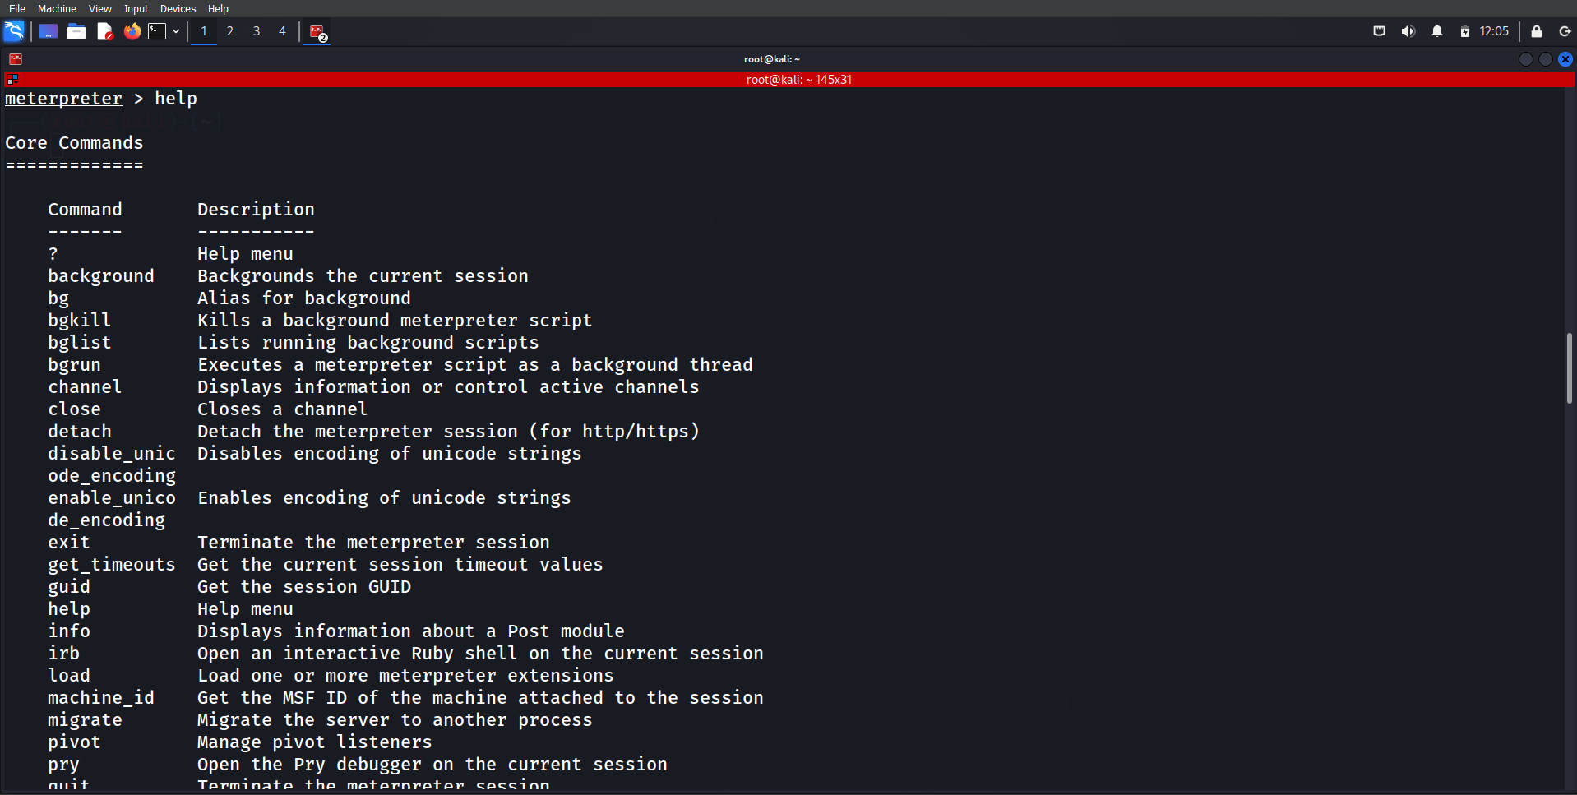
Kali :- search Help command

Slide 28
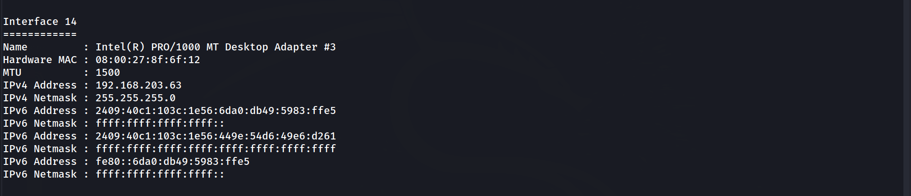
Kali :- write ipconfig
Kali :- You will get ip address of Windows

Slide 29
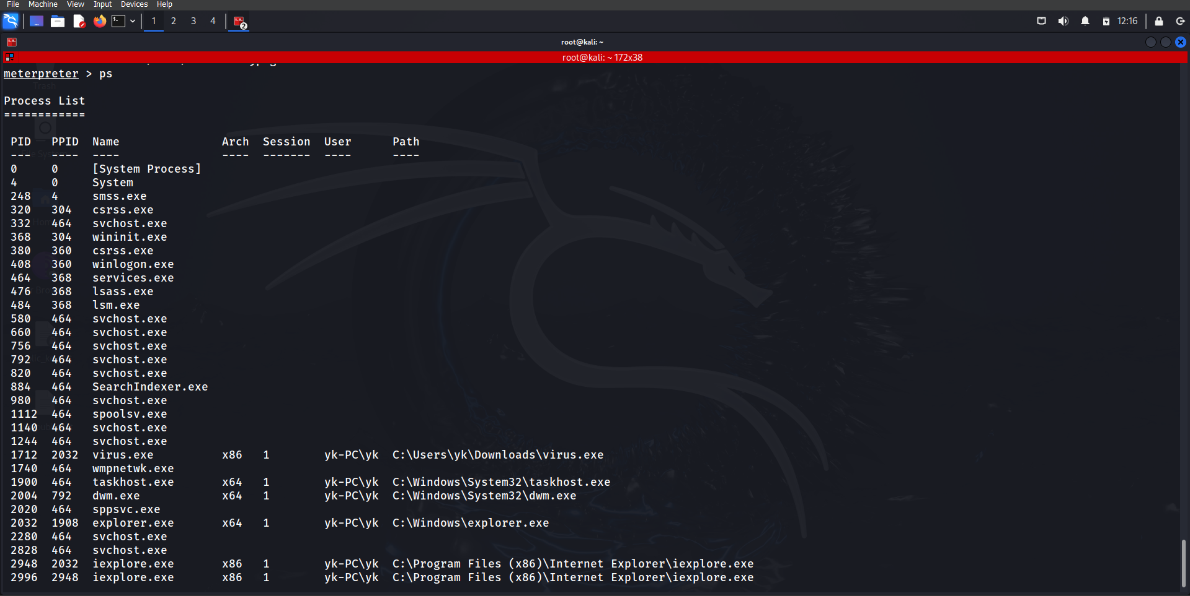
Kali :- List Running Processes

Slide 30
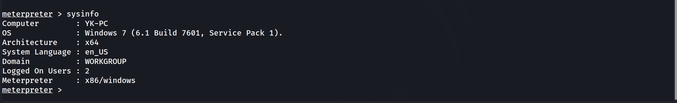
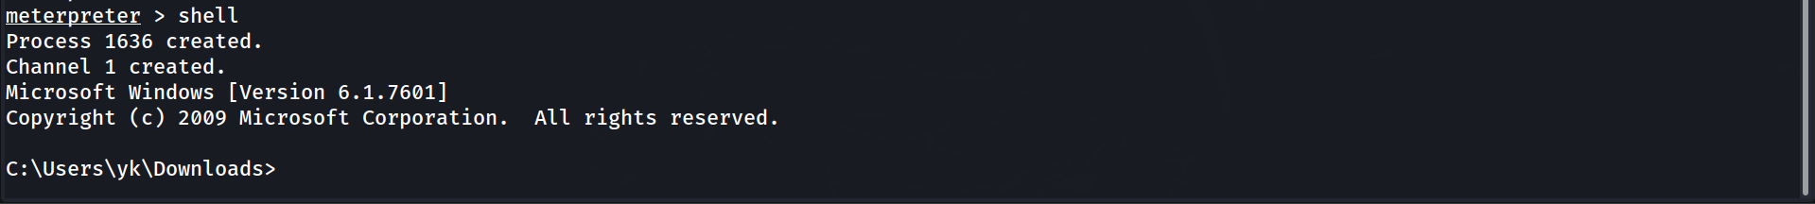
Kali :- check the sysinfo
Kali :- Go to shell in windows
Kali :- change directory

Slide 31
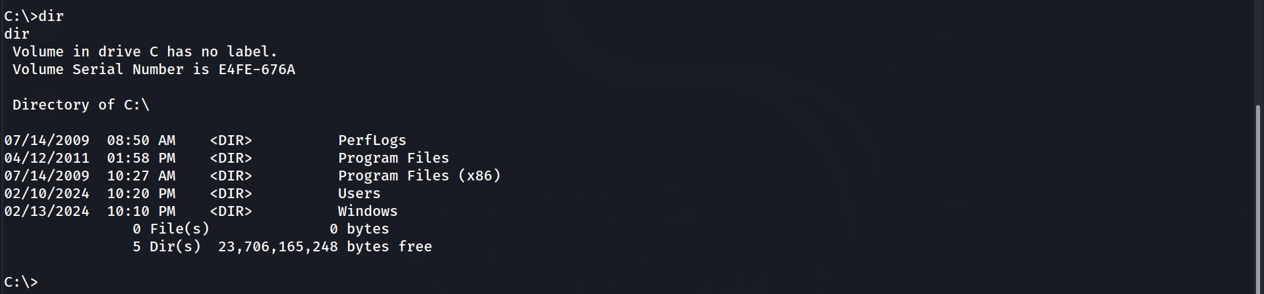
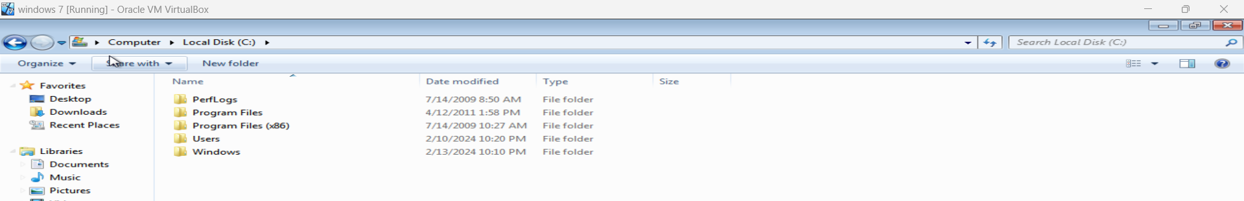
Kali :- check the Directory
Windows :- check the Directory

Slide 32
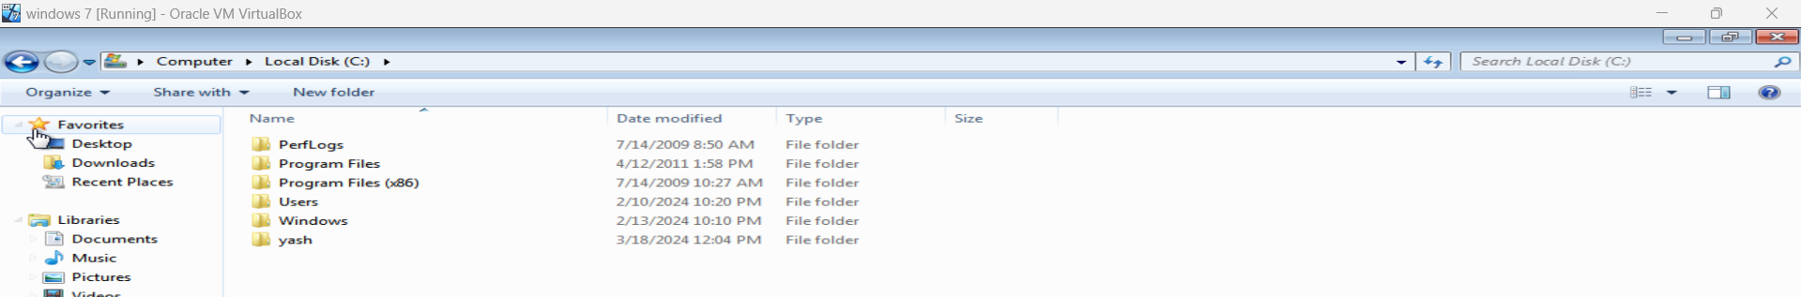
Kali :- creating a folder in Windows C drive
Windows : - Folder is create

Slide 33
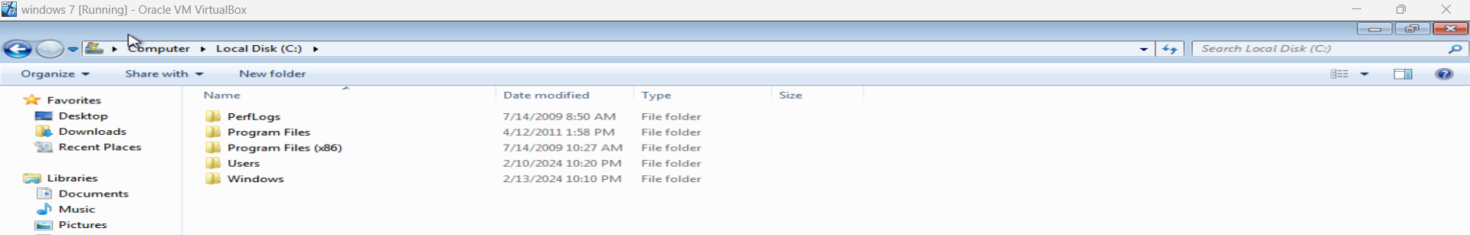
Kali :- Removing a folder in Windows C drive
Windows : - Folder is remove

Slide 34
Kali :- for exiting the session

Slide 35

THANK YOU

